Slide 1
رقم الجلوس | الاسم
2021170366 | عمر محمد محمود موافي
2021170461 | محمد حسين حسن
2021170334 | علي خالد عبدالعال عبدالبر
2021170436 | مازن رأفت عبدالحميد مصطفى
2021170342 | علي نادر نبيل أحمد عفيفي
2021170441 | ماير سليمان هدية سليمان

Slide 2
Agenda
Pre-Processing: From page 4 to 10
Power-BI: From page 11 to 12
Time series: From page 13 to 20
Apply model & evaluation: From page 21 to 26

Slide 3
Introduction
The Walmart Sales Problem Analysis. This project is part of our Business Intelligence coursework, aimed at leveraging data pre-processing and machine learning techniques to provide actionable insights to Walmart’s management team. We will explore sales data to identify trends, correlations, and patterns that can guide strategic decisions.

Slide 4
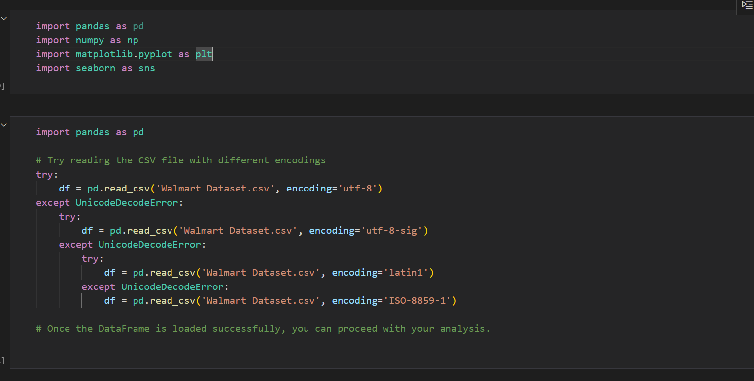
First we read the File

Slide 5
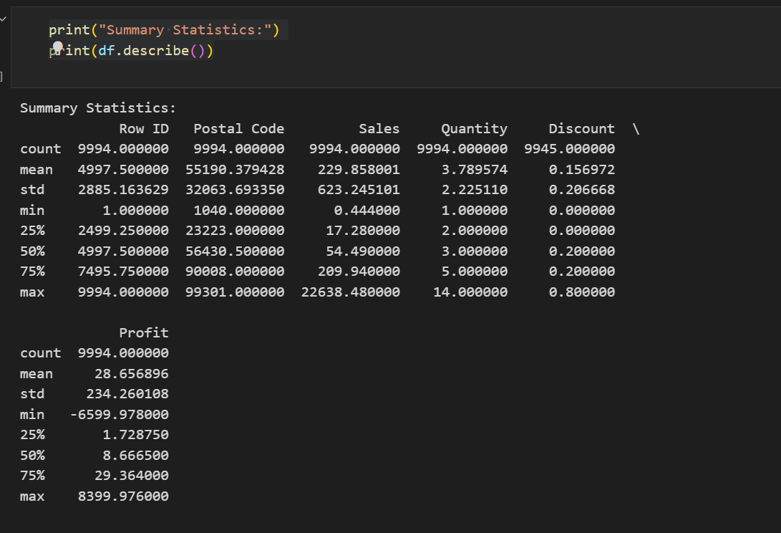
We did a quick summary of the file

Slide 6
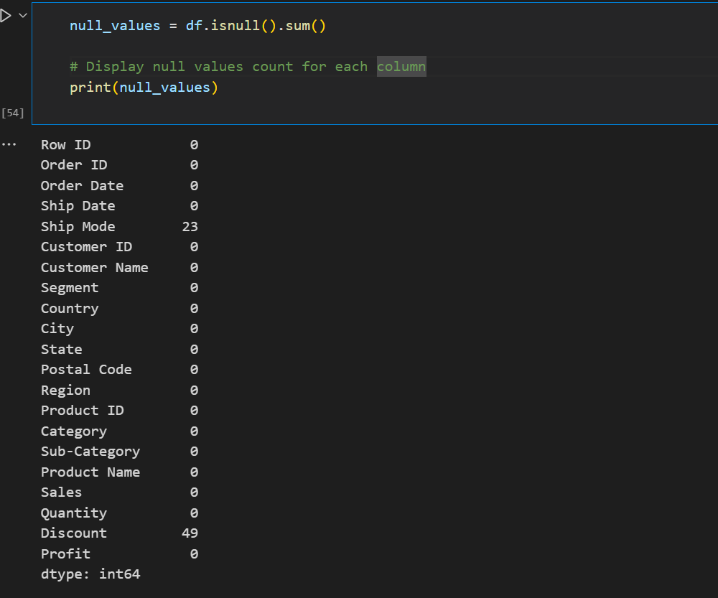
We checked for null values in the dataset

Slide 7
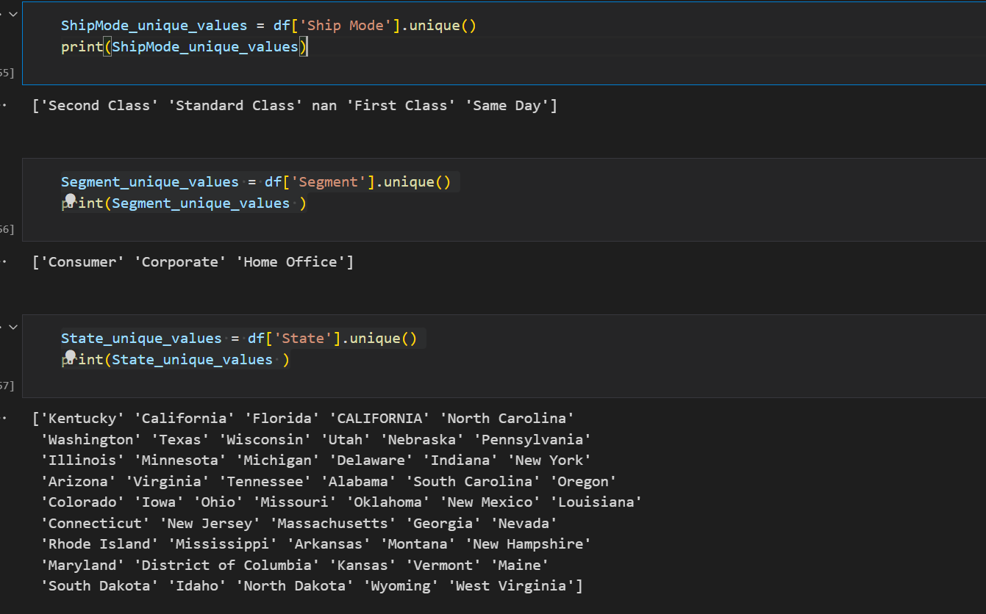
We checked for inconsistent data

Slide 8
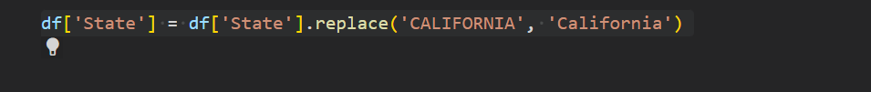
We replaced the inconsistent data

Slide 9
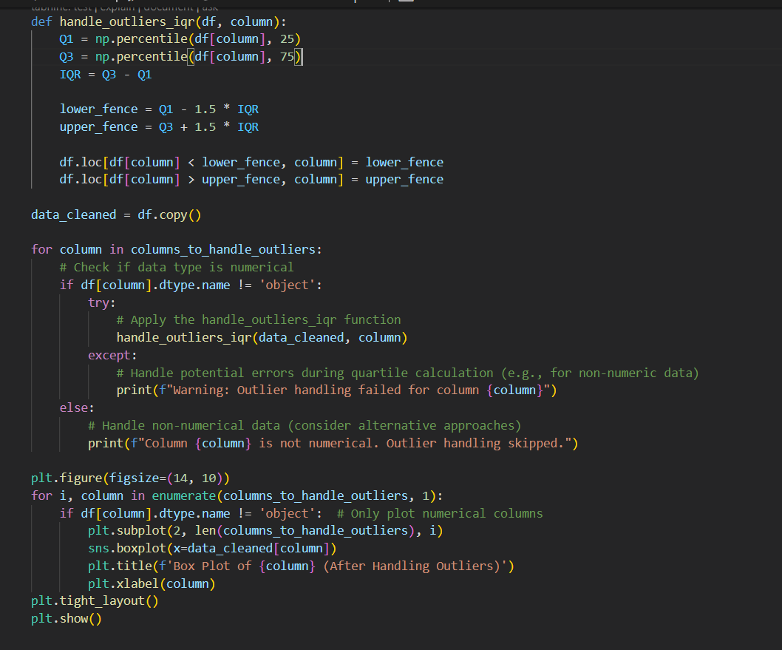
Solving Outliers

Slide 10
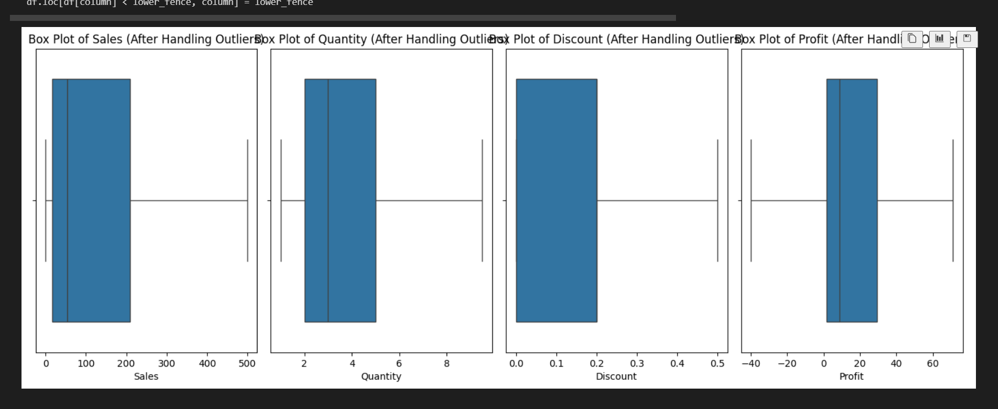
After Solving outliers

Slide 11
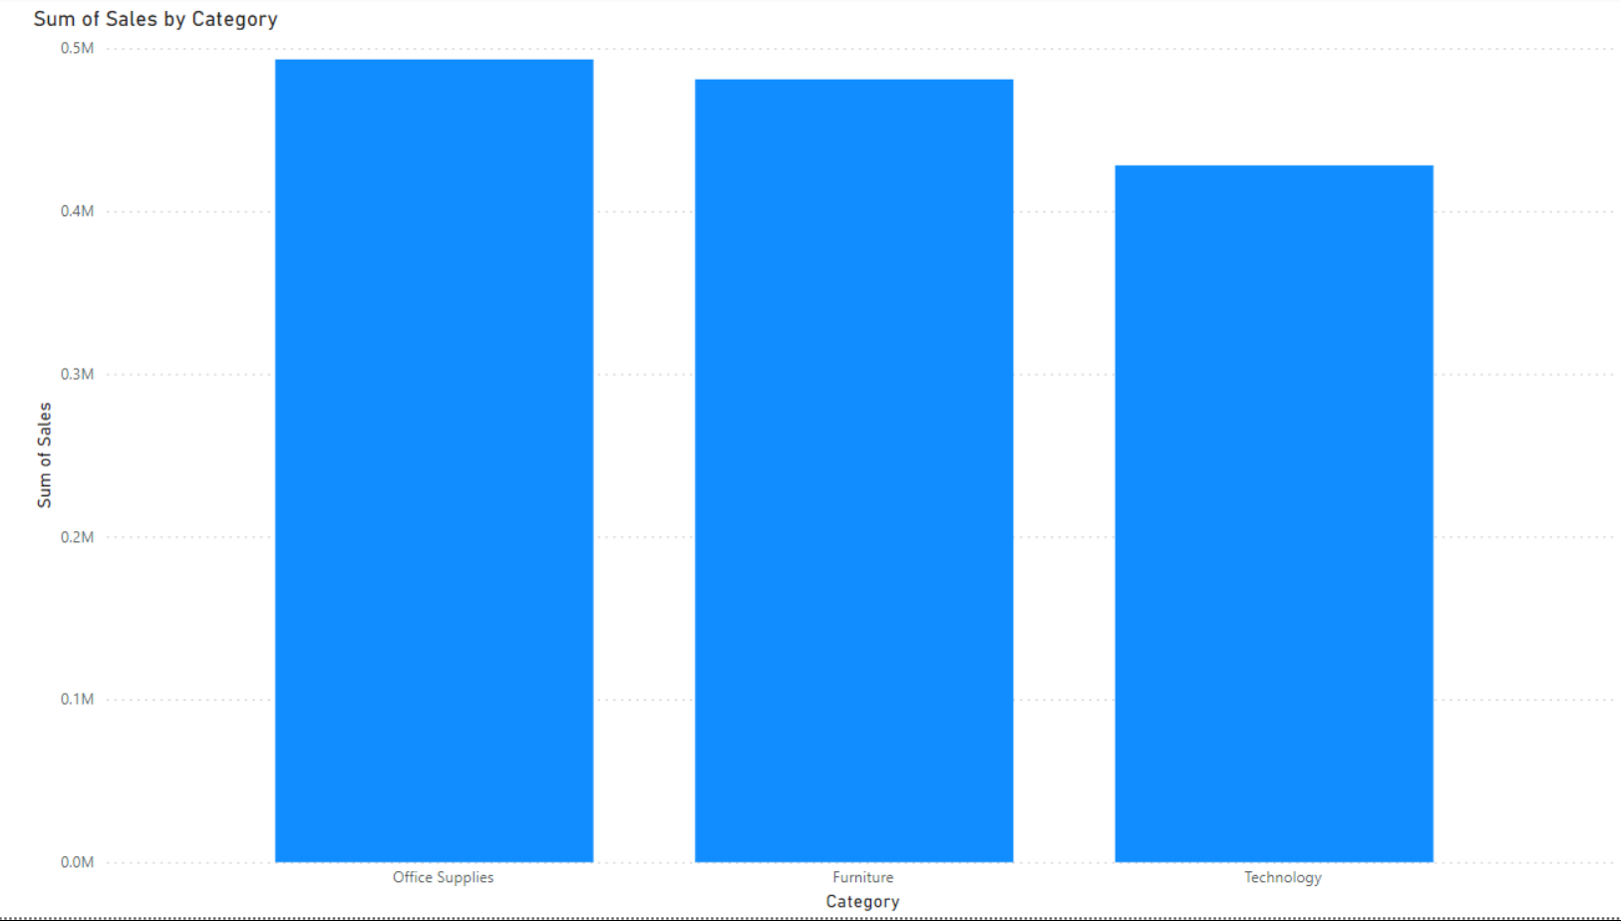
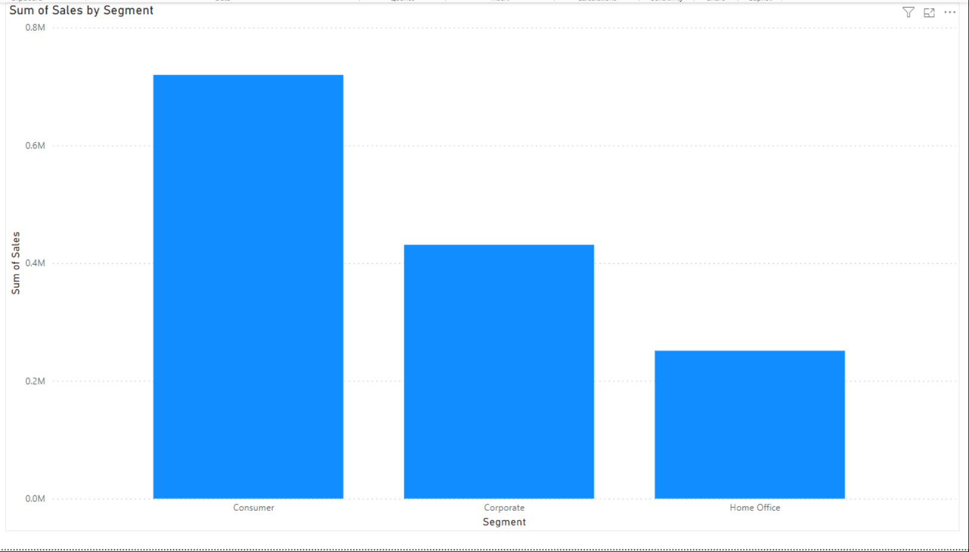
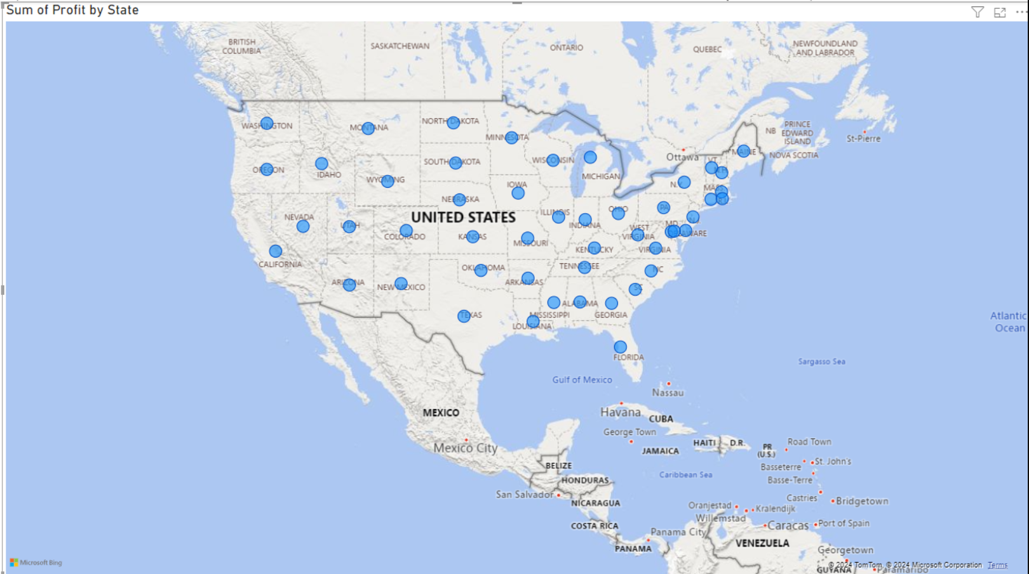
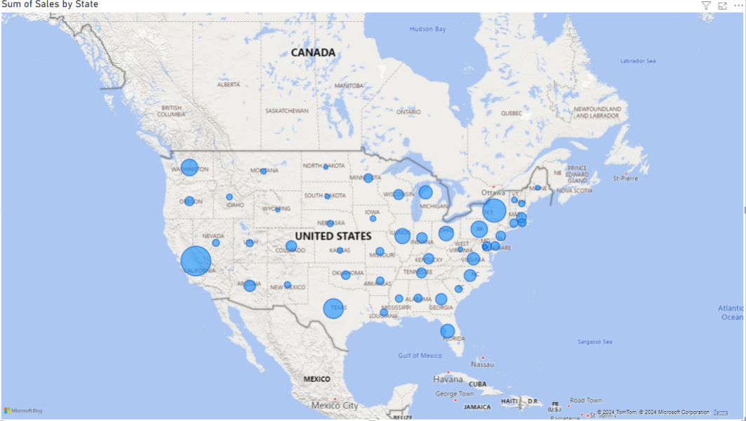

Slide 12
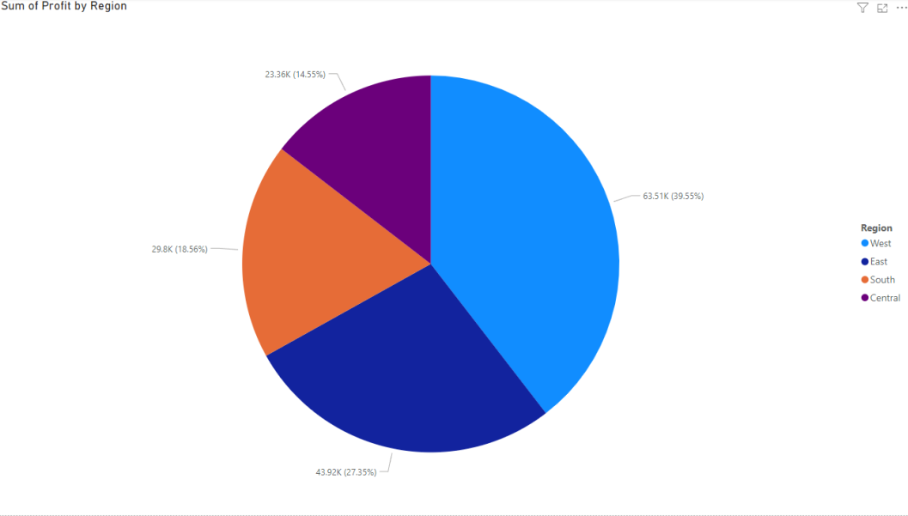
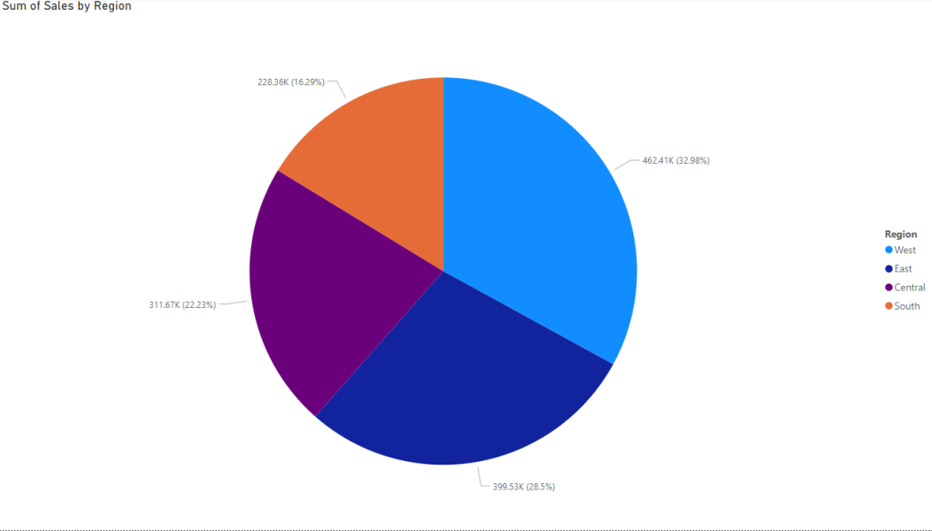
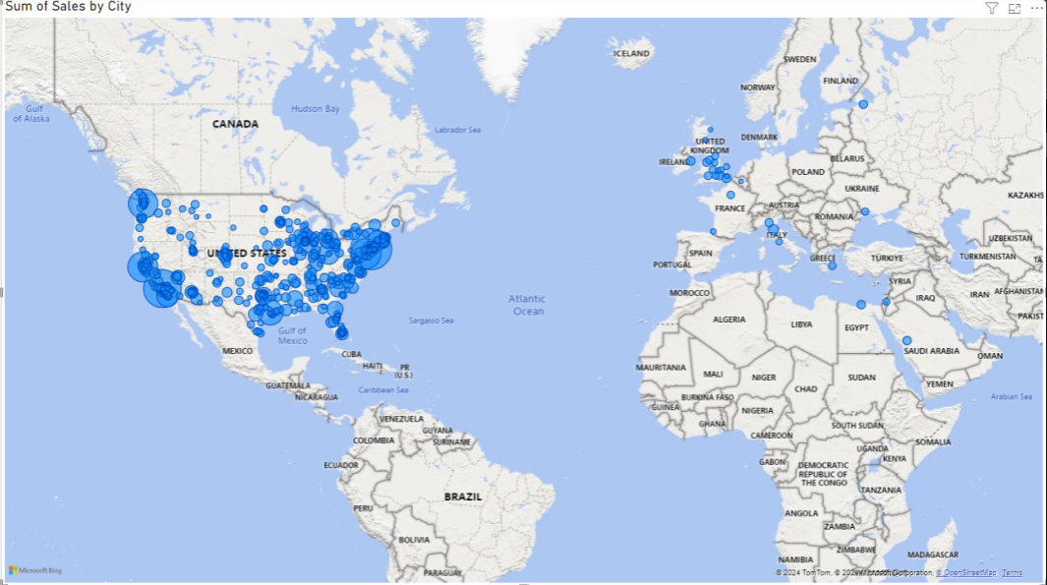
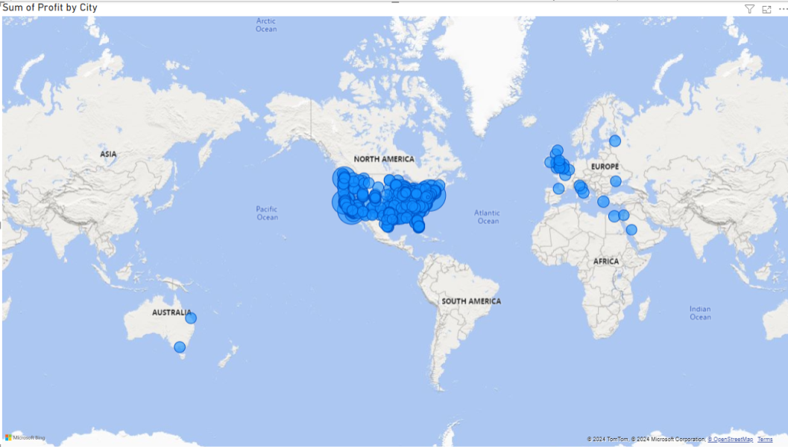

Slide 13
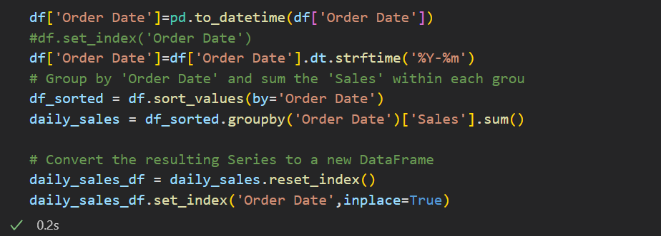
We format the data

Slide 14
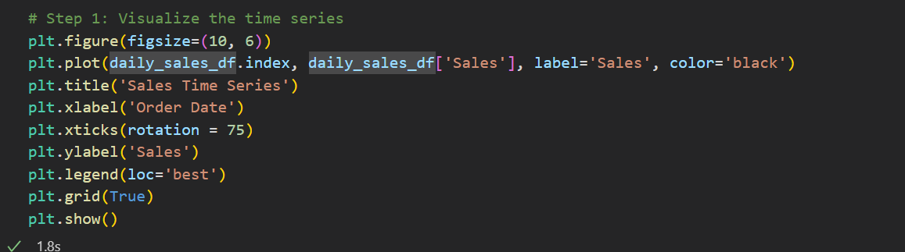
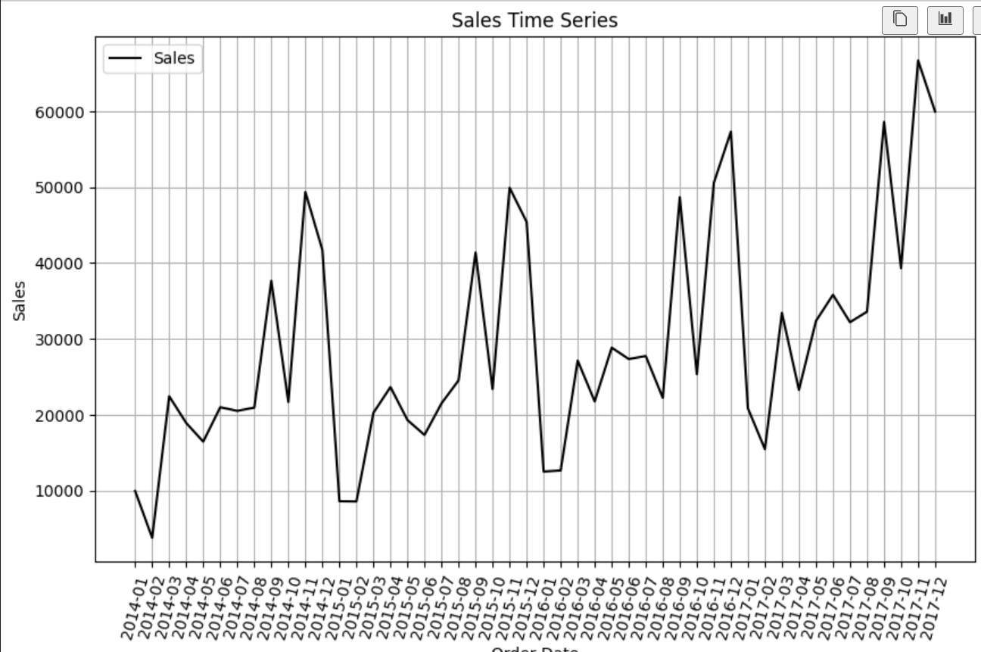
Visualize data
Notes:
Seasonality and trend exists

Slide 15
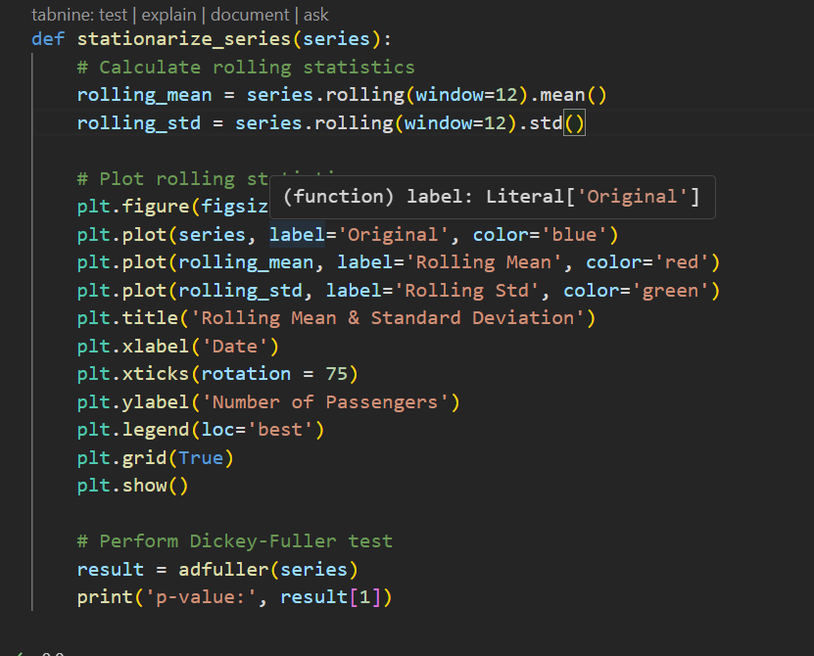
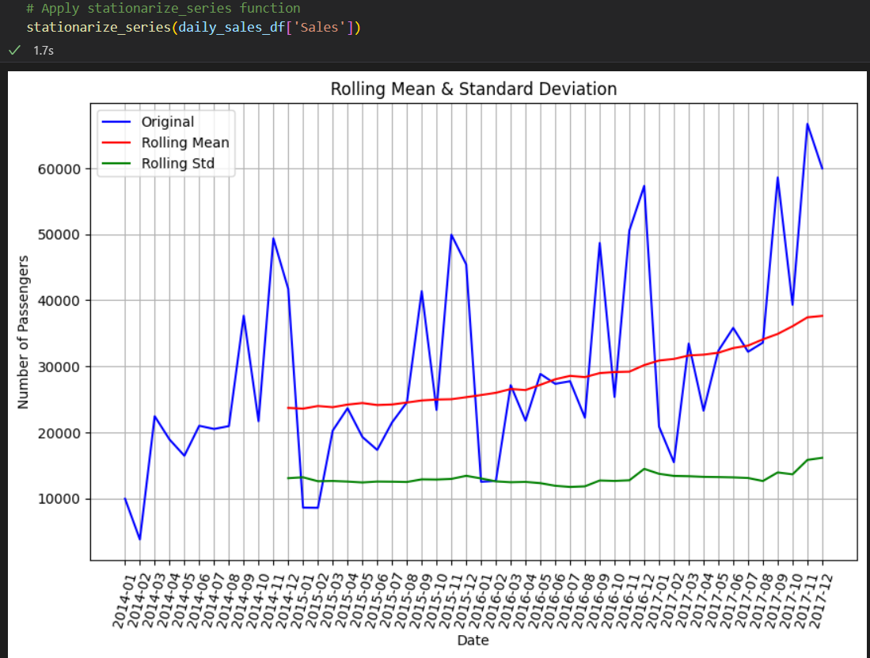
Stationarize function

Slide 16
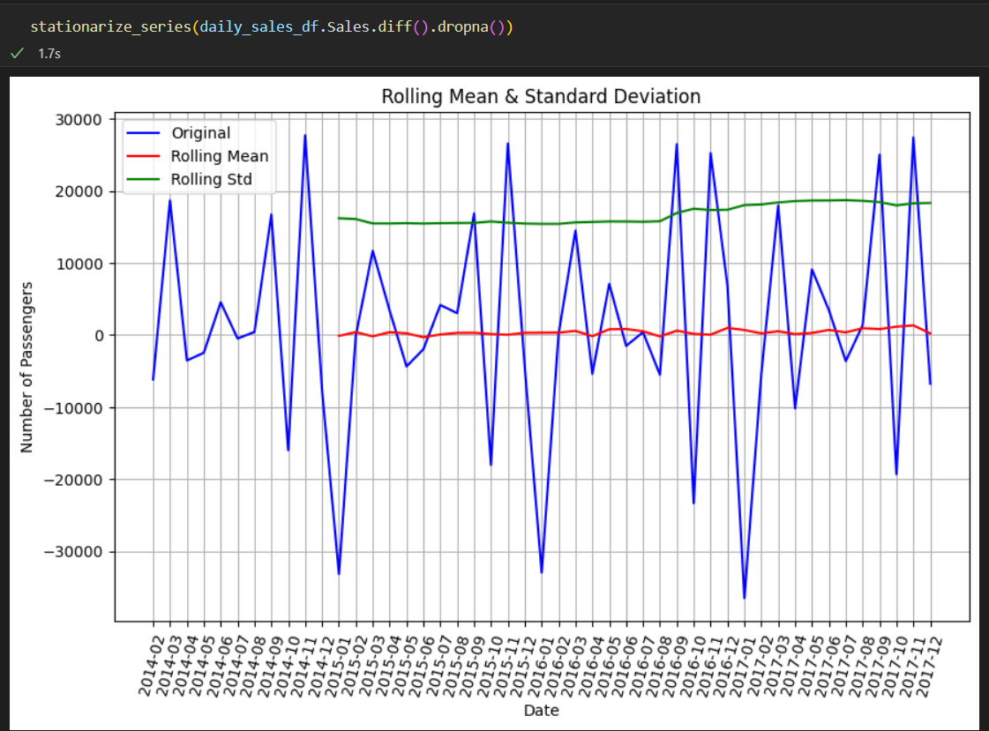
After applying the differencing

Slide 17
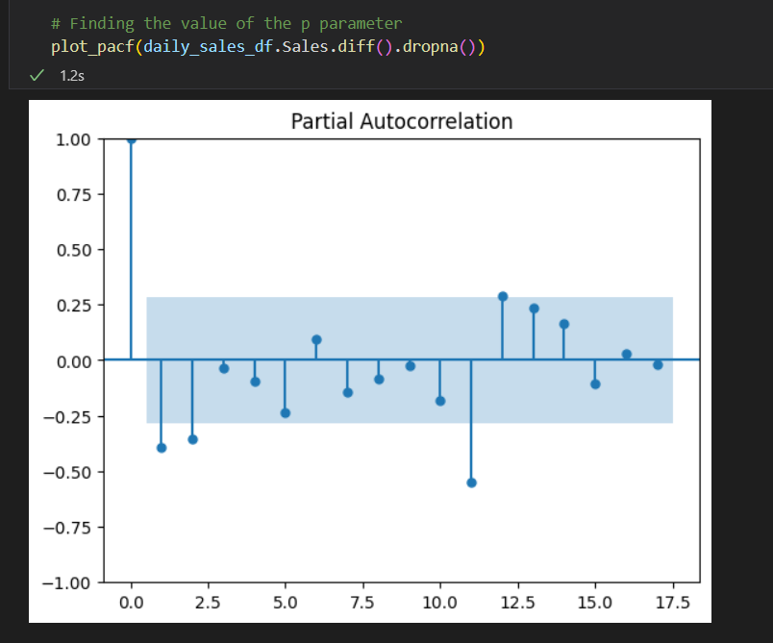
After applying the P-ACF plot

Slide 18
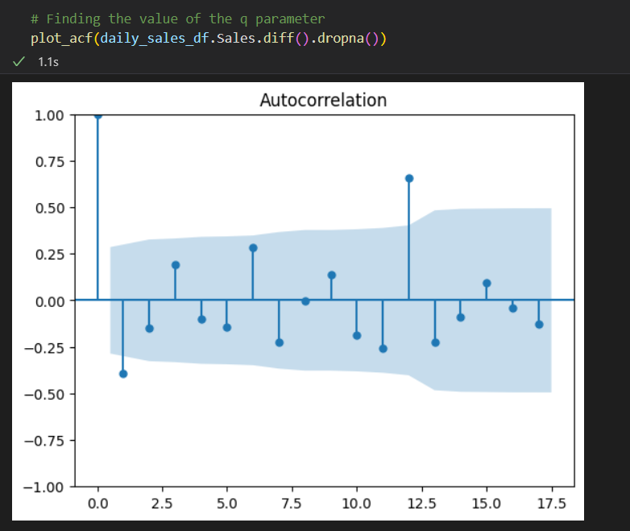
After applying the ACF plot

Slide 19
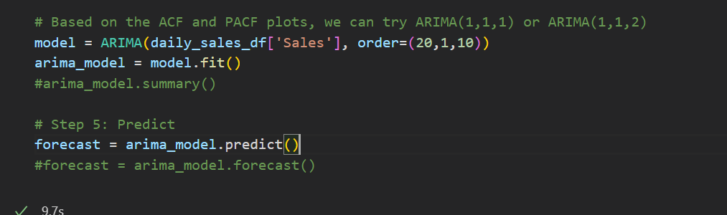
After applying the ARIMA model and prediction

Slide 20
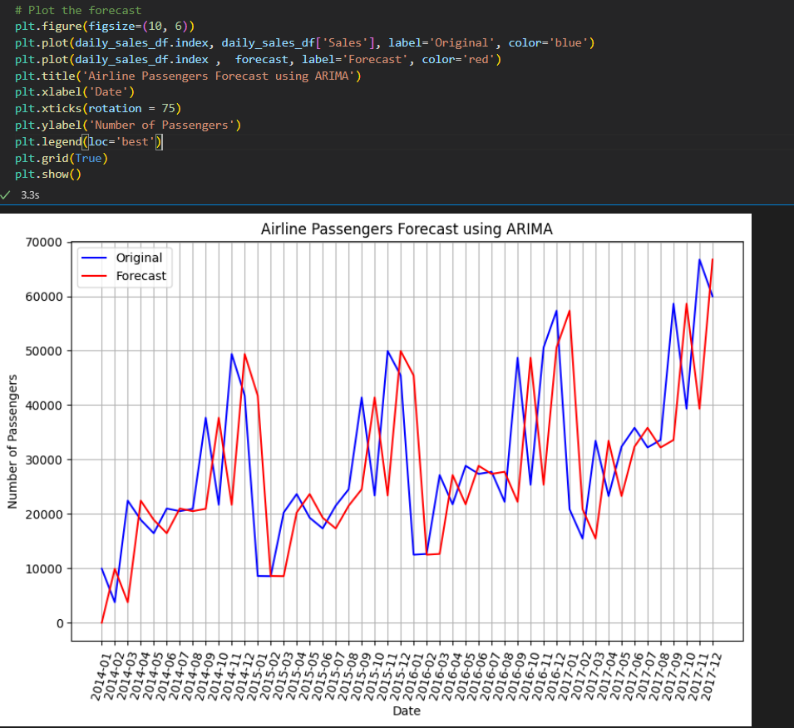
After plotting the forecast

Slide 21
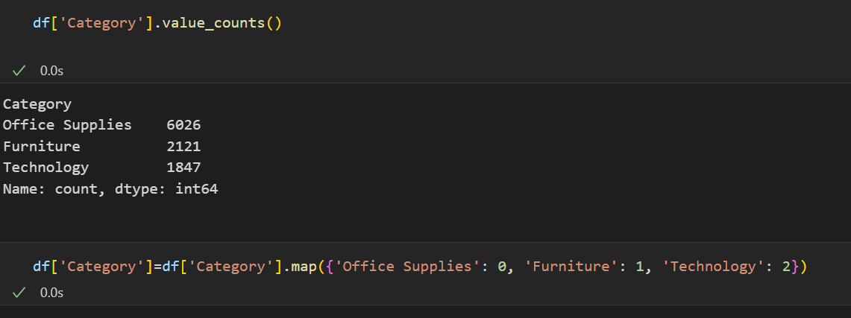
Replacing the category column with numerical data

Slide 22
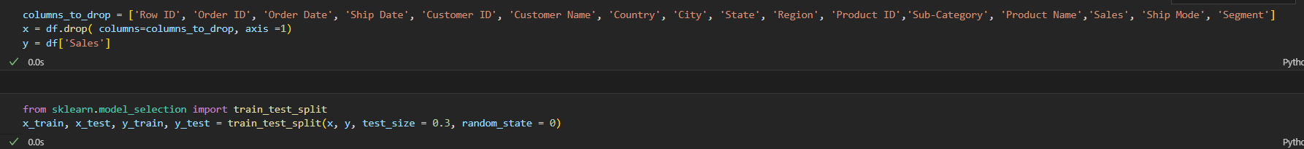
Splitting the data

Slide 23
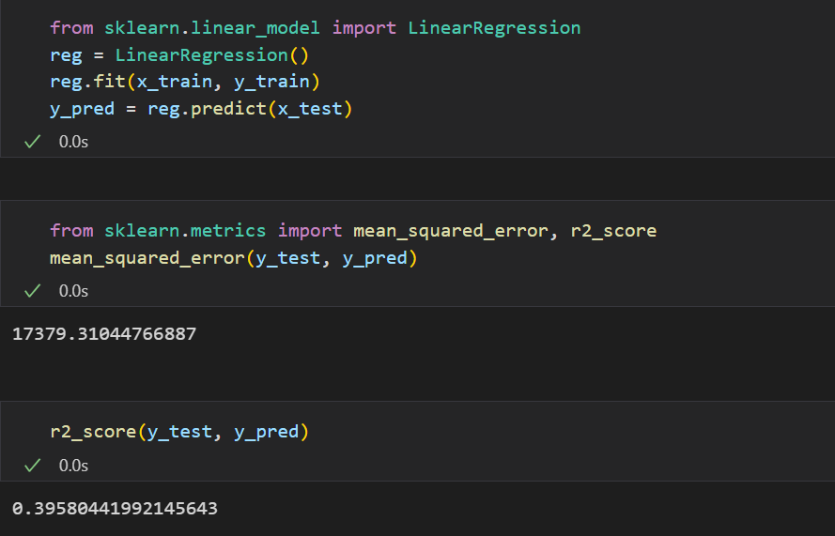
Applying linear regression model and evaluation

Slide 24
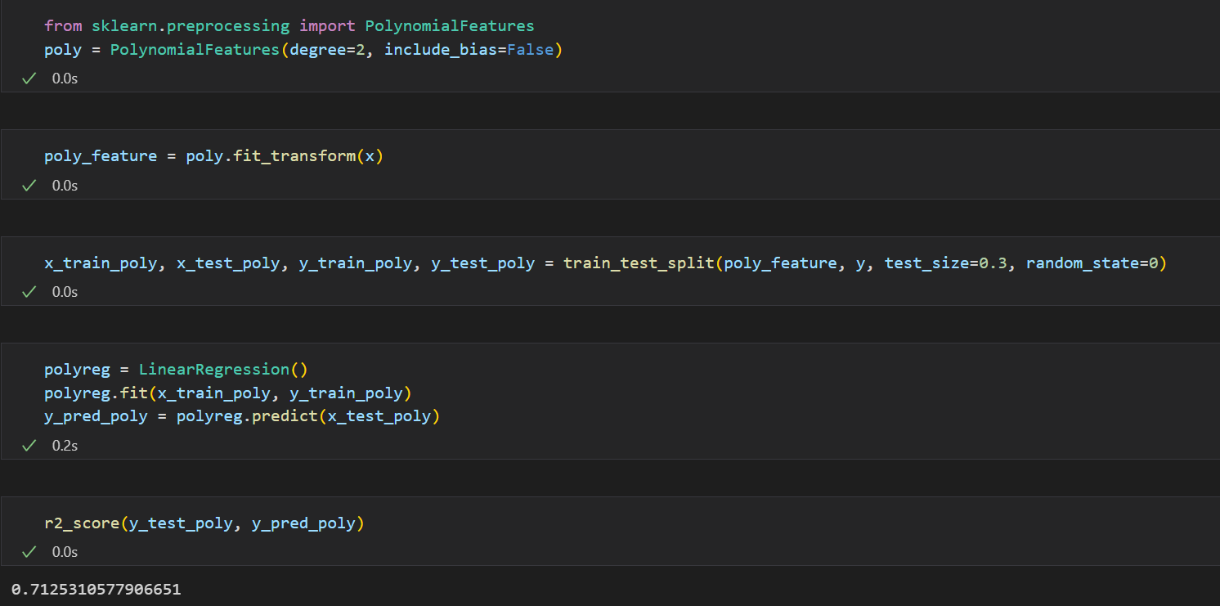
Applying the polynomial regression and evaluation

Slide 25
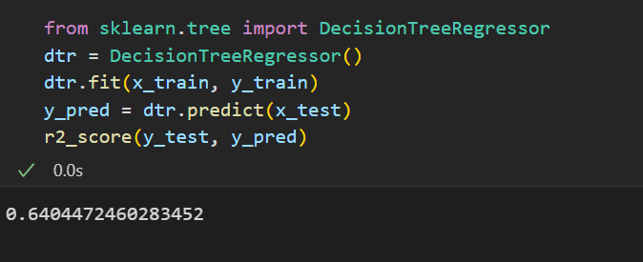
Applying the decision tree regressor and evaluation

Slide 26
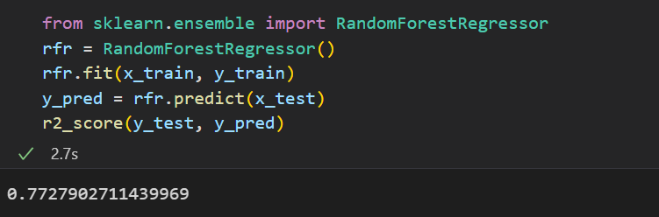
Applying the random forest regressor and evaluation

Slide 27
Conclusion
In conclusion, our analysis will equip Walmart with valuable insights into their sales performance across various dimensions. By identifying key trends and relationships within the data, we can provide recommendations that will help Walmart target high-performing products, regions, and customer segments, thereby driving growth and profitability.

